Slide 1

:Pickr A Cutting-edge Social Network
Owners
Farbod Samsamipour Ehsan Nezhadian Mina Khalilinejad Ali Beyhaghi Mohammad Ali Gharabaghi

Slide 2

Responsive Web Design
The idea of Responsive Web Design, a term coined by Ethan Marcotte, is that our websites should adapt their layout and design to fit any device that chooses to display it.
Fluid grid
Fluid images
Media queries

Slide 3
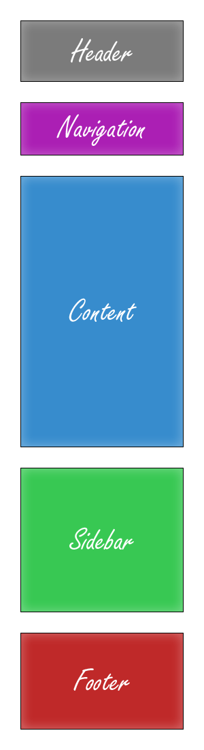
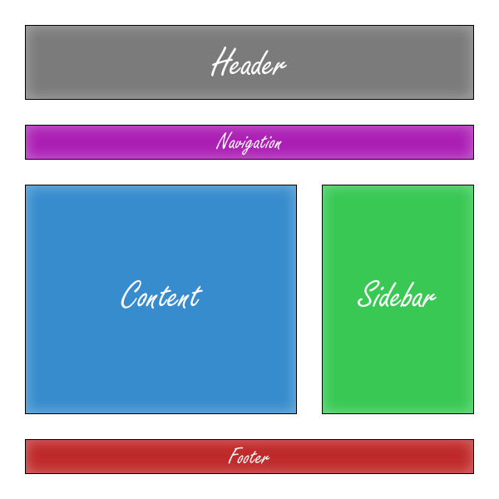
Responsive Web Design (Cont.)
A complete web page

Slide 4

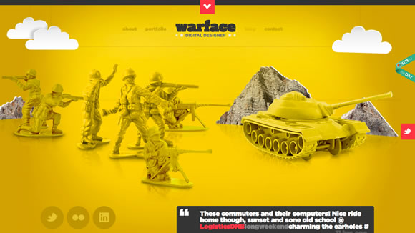
Responsive Web Design (Cont.)
Example (1)

Slide 5
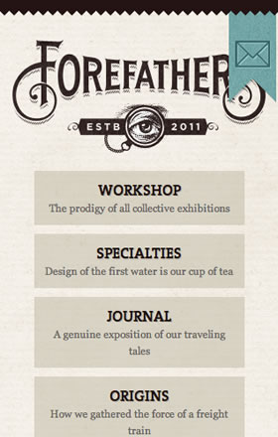
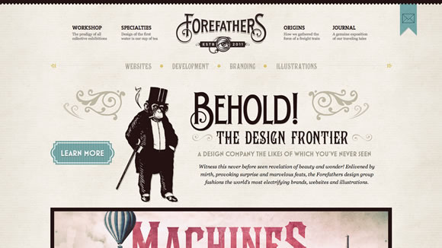
Responsive Web Design (Cont.)
Example (2)

Slide 6


Responsive Web Design (Cont.)
Example (3)

Slide 7

Bootstrap
By nerds, for nerds.
Built at Twitter by @mdo and @fat, Bootstrap utilizesLESS CSS, is compiled via Node, and is managed through GitHub to help nerds do awesome stuff on the web.

Slide 8

Bootstrap (Cont.)
Made for everyone.
Bootstrap was made to not only look and behave great in the latest desktop browsers (as well as IE7!), but in tablet and smartphone browsers via responsive CSS as well.

Slide 9

Bootstrap (Cont.)
Packed with features.
A 12-column responsive grid, dozens of components,JavaScript plugins, typography, form controls, and even a web-based Customizer to make Bootstrap your own.

Slide 10
Boilerplate
★ Analytics, icons, and more
A lean, mobile-friendly HTML template; optimized Google Analytics snippet; placeholder touch-device icons; and docs covering dozens of extra tips and tricks.
★ Normalize.css and helpers
Includes Normalize.css v1.0.x — a modern, HTML5-ready alternative to CSS resets — and further base styles, helpers, media queries, and print styles.
★ jQuery and Modernizr
Get the latest minified versions of two best-of-breed libraries: jQuery (via Google’s CDN, with local fallback) and the Modernizr feature detection library.
★ High performance
Apache settings to help you deliver excellent site performance. We independently maintain other server configs, a node build script, and an ant build script.

Slide 11
Who uses HTML5 Boilerplate?
Google
Microsoft
NASA
Nike
Barack Obama
Mercedes-Benz
ITV News
BAE Systems
Creative Commons
Australia Post
Entertainment Weekly
Racing Green

Slide 12

Modernizr
Modernizr is a JavaScript library that detects HTML5 and CSS3 features in the user’s browser.

Slide 13
Who uses Modernizer?
Google
Microsoft
The Economist
About.com
The Knot
GOOD Magazine
Posterous

Slide 14

Lazy Loading
Lazy Load is a jQuery plugin written in JavaScript. It delays loading of images in long web pages. Images outside of viewport (visible part of web page) wont be loaded before user scrolls to them. This is opposite of image preloading.

Slide 15
Lazy Loading (Cont.)
Using Lazy Load on long web pages containing many large images makes the page load faster. Browser will be in ready state after loading visible images. In some cases it can also help to reduce server load.

Slide 16
Tank Auth
Tank Auth is an authentication library for PHP-framework CodeIgniter. It's based on DX Auth, althouth the code was seriously reworked.

Slide 17
Tank Auth (Cont.)
Login using username, email address or both (depending on config settings).
Registration is instant or after activation by email (optional).
"Remember me" option.
Forgot password (letting users pick a new password upon reactivation).
Change password or email for registered users.
Email or password can be changed even before account is activated.
Ban user (optional).
User Profile (optional).
CAPTCHA support (CI-native and reCAPTCHA are available).
HTML or plain-text emails.

Slide 18
Form Validation
Client Side
Using jQuery and CSS
Server Side
Using PHP and AJAX

Slide 19
Use Cases
Login
Logout
Register
Forgot password
User Profile

Slide 20
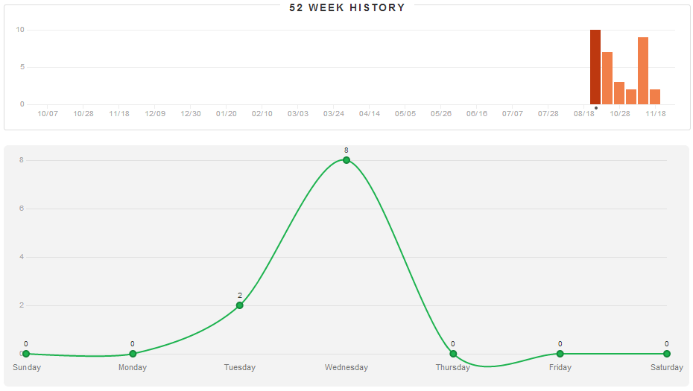
Members Activity

Slide 21
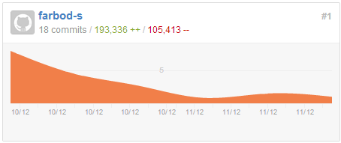
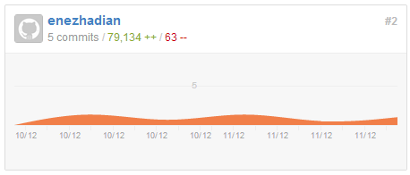
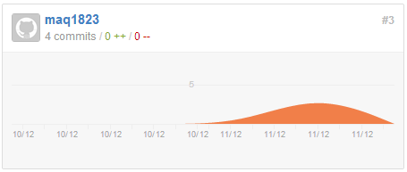
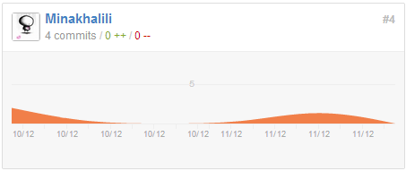
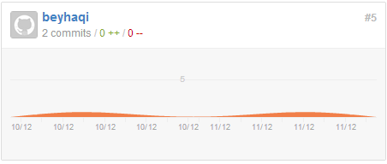
Members Activity (Cont.)

Slide 22
THE END
Thank you for your attention

